Slide 1
Network events – GCSE English – Spring 2016

Slide 2
Session Agenda
AO4: Evaluation – workshop and discussion
Spoken Language Endorsement – looking at examples
Active Teach: Introduction to the free resources
Questions and ideas for next network event
Notes:
Again – as last time round – stress that the agenda isn’t fixed and we can chat about whatever is needed on the day.
Start with an informal chat about how the term is going etc and then go through the agenda and the pack
This is a very ‘Language’ focused event so we would be happy to look at literature next time!
2

Slide 3
AO4: Evaluation

Slide 4
Aims and objectives
Examine the definition of evaluation
Interpret the assessment objective and requirements of students, including relationship with AO2
Review evaluation in the question paper and mark scheme
Look at ways of supporting AO4 in the classroom
Notes:
Again – as last time round – stress that the agenda isn’t fixed and we can chat about whatever is needed on the day.
Start with an informal chat about how the term is going etc and then go through the agenda and the pack
This is a very ‘Language’ focused event so we would be happy to look at literature next time!
4

Slide 5


Activity One
Evaluate these cars in 1 minute
Notes:
Give one minute for the activity

Slide 6

Activity One
In the activity, you:
made a judgement, assessed, appraised
may have been positive or negative
will have been reflecting on your own needs or those of other audiences
Notes:
Take some feedback briefly. Overall the definition of evaluation is to make a judgement about something or determine its value through a personal response. The responses may have been different, which is fine – evaluation is a personal opinion or critical judgement.

Slide 7
Evaluation in AO4
Evaluate texts critically and support this with appropriate textual references
Command
Level
Evidence
Notes:
AO4 is 18.75% of the overall GCSE and is assessed on both Paper 1 and Paper 2
There is one question on each paper that assessed AO4 and in both questions it assesses ONLY AO4

Slide 8
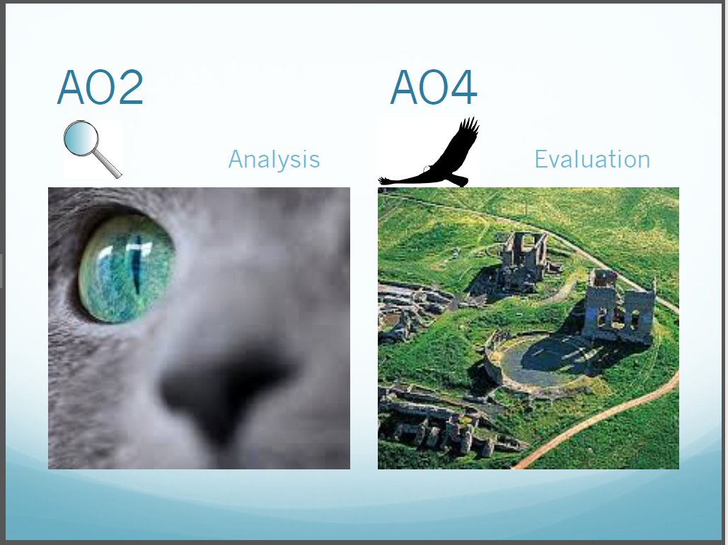

Slide 9
AO4 versus AO2
AO4: Evaluate texts critically and support this with appropriate textual references
AO2: Explain, comment on and analyse how writers use language and structure to achieve effects and influence readers, using relevant subject terminology to support their views
Command
Command
Notes:
The command in AO4 asks students to show ‘to what extent’
The command in AO2 asks students to show ‘how’
AO2 asks how the writer does something specific (use language and structure to achieve effects and influence readers) and AO4 asks how successful they are overall.

Slide 10
AO4 versus AO2
AO4: Evaluate texts critically and support this with appropriate textual references
AO2: Explain, comment on and analyse how writers use language and structure to achieve effects and influence readers, using relevant subject terminology to support their views
Level
Level
Notes:
In AO4 the level of success in achievement is in the extent to which the students respond critically.
In AO2 the level of success in achievement is in the command – the students need to move from explanation, to comment, to analysis at the highest level

Slide 11
AO4 versus AO2
Evidence
AO4: Evaluate texts critically and support this with appropriate textual references
AO2: Explain, comment on and analyse how writers use language and structure to achieve effects and influence readers, using relevant subject terminology to support their views
Evidence
Notes:
In AO4 points are evidenced by the use of references to the text. There is no requirement to use subject terminology
In AO2 points are on language and structure specifically and are evidenced by the use of examples and subject terminology
AO2 is focussed analysis on the language and structure, where AO4 asks candidates to step back and view the wider scene – this is where ‘SITE’ is useful.

Slide 12
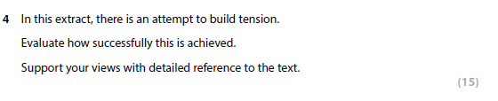
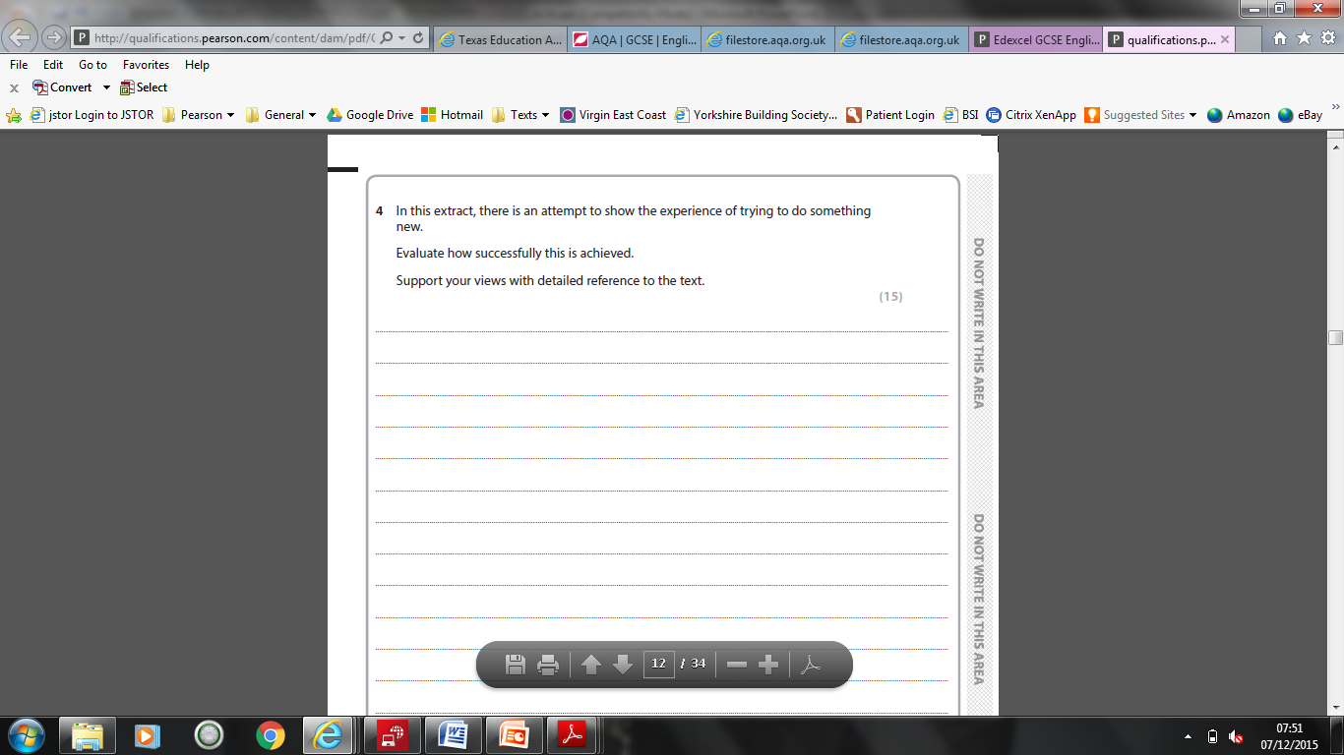
AO4 Question On both papers the question will always follow the same format:
Paper 1 – Question 4
Notes:
The stem will always be ‘In this extract, there is…’
What follows is standard

Slide 13
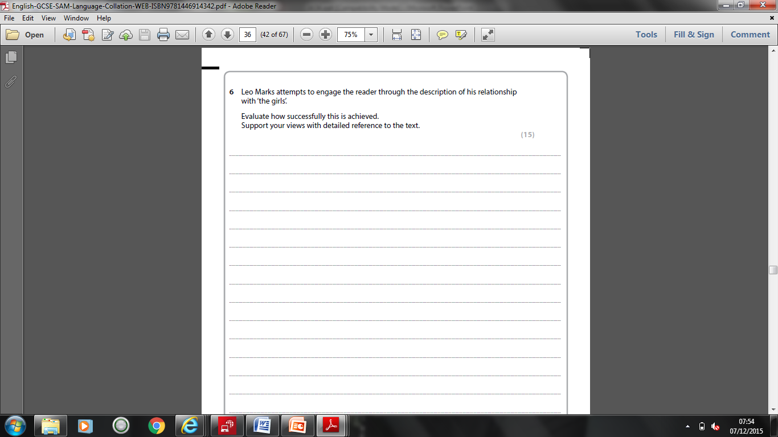
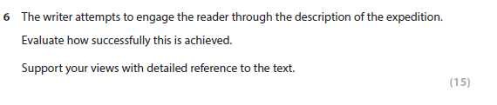
AO4 Question
Paper 2 – Question 6
Notes:
Again, the ‘evaluate’ section is identical

Slide 14
AO4 Questions and Mark Scheme
Paper 1 assesses AO4 in Question 4
Paper 2 assesses AO4 in Question 6
The format of the questions will always follow the same pattern
The questions always refer to only one extract and the whole extract
Questions are always worth 15 marks
The mark scheme is identical for both questions with five levels
Notes:
Reassuring for teachers as expectations are always clear and easy to understand, and the mark scheme is standard.

Slide 15
Getting Started: Approaching AO4
Students should:
Highlight the key words of the question – command, level, evidence
2. Know the three bullets of the mark scheme – writing, opinion, reference
3. Focus on examining SITE – Setting, Ideas, Theme, Events
Notes:
SITE is a technique to remember the different areas to comment on in any text – these are referenced in the mark scheme. This links to the stepping back, observing the whole text and taking a wider view.
It is not necessarily the case that all four can be or need to be commented on to achieve top marks – some areas may not be relevant in the text examined.

Slide 16
Using the Field of White Space as a ‘SITE’
A useful technique to start off evaluation is ‘Field of White Space’
Take the text and put it in the centre of an A3 or A4 sheet
2. Use SITE prompts to encourage evaluative comment
Notes:
This is one possible technique – but is not the only one!

Slide 17
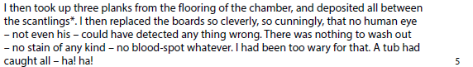
Field of White Space
Setting:
To what extent is
the setting tense?
Theme:
What theme is
being presented?
Ideas:
What ideas are
presented
here and how
tense are they?
Events:
To what extent are
the events tense?
Notes:
This is the first section of the text from the SAMS
In a small section of the text there may not be a need to evaluate all of the SITE areas, but questions can be posed to encourage comment

Slide 18
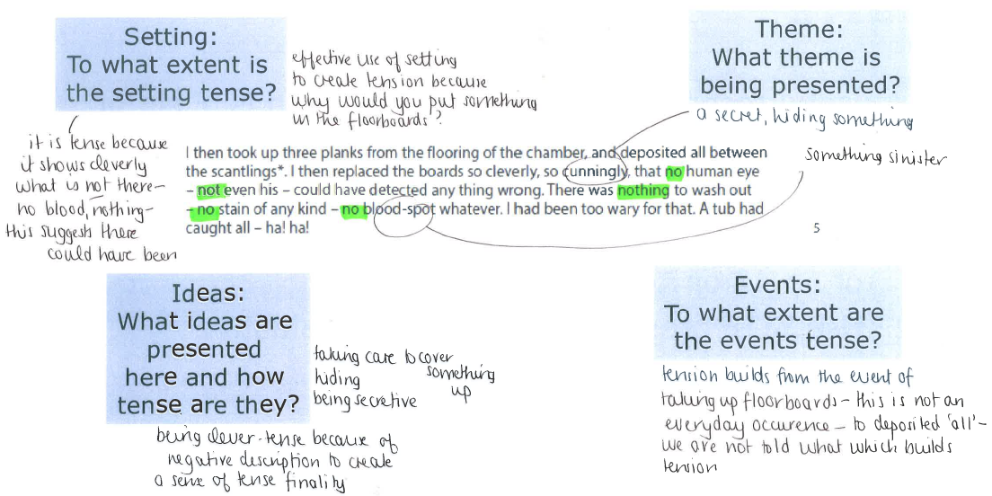
Field of White Space
Notes:
This is some possible comment a student may offer. Different sections of the text could be examined, then a full response produced.

Slide 19
Crafting an extended response
Once the full text has been examined, students could be encouraged to work with the whole extract using a skim, scan, select technique.
This could use a table, map, diagram, for example:
What is presented | How well is this presented? | Evidence
Setting:
Ideas:
Theme:
Events:

Slide 20
Crafting an extended response
What is presented | How well is this presented? | Evidence
Setting: | Evaluate how the choice of setting affects the work's theme and mood
Ideas: | For example, the people in the text: main and secondary characters and their roles and purposes
Theme: | What is the writer is trying to communicate overall? Are there ‘sub’ themes?
Events: | Is there an opening, climax, resolution? Where these are in the plot's development has a role in the author's success in conveying meaning.
Notes:
These are the kind of areas that can be commented on.

Slide 21
Activity Two
Getting Started - Interpreting the Mark Scheme
Examine the bullet points of the mark scheme, highlighting only one or two key words from each
Notes:
Give five minutes for this activity, using a copy of the AO4 mark scheme

Slide 22
Interpreting the mark scheme
Level 1 | Description, limited assertions and references
Level 2 | Comment, straightforward opinions with limited judgements, valid but underdeveloped references
Level 3 | Explanation, informed judgement, appropriate and relevant references
Level 4 | Analysis, well-informed and developed critical judgement, appropriate, detailed and fully supportive references
Level 5 | Evaluation, sustained and detached critical overview and judgement, apt and discriminating and persuasive references.
Notes:
Three key areas:
Quality of writing (description, comment, explanation, analysis or evaluation)
Level of opinion (assertion, opinion, judgement, critical overview)
Level of reference (limited, underdeveloped, appropriate, relevant, detailed, discriminating)

Slide 23
Assessing the level of opinion
Level | Example
1: Limited assertion | ‘I think he builds tension well.’
2: Straightforward opinion | ‘the tension begins to rise and it goes from very calm to very tense.’
3: Informed judgement | ‘The section from the extract doesn't contain the object placed beneath the flooring. This is building tension in many ways because the reader would want to know what it is and read on. Throughout this extract two policemen enter the scene wanting to examine anything suspicious. They all sat in the chamber where the body lay.’
Notes:
The responses should focus on ‘how well’, not ‘how’ – ‘how’ is assessed in AO2.
Level 3: there is some informed judgement about the success of the building of tension. This is seen in the broad explanation linked to the theme of secrecy in the first part of the response, and in the explanation of the idea of risk.
Evaluative language is text in red.

Slide 24
Assessing the level of opinion
Level | Example
4: Well-informed and developed critical judgement | ‘The vocabulary used suggests the idea of prizes and winning, e.g. 'treasure', 'triumph'. The writer makes it seem like the narrator is just playing a game or a sport which comes up as a theme in the piece and helps to build tension. He thinks he has won. The first four paragraphs make it seem like everything is just covering up like the narrator planned. The last paragraph where he is caught doesn't have much of a transition from previous paragraphs. The small amount of transition then leads you to a burst of tension. The game is over.’
Notes:
The responses should focus on ‘how well’, not ‘how’ – ‘how’ is assessed in AO2.
Level 4: There is well-informed and developed judgement in the explained comment about the way that the writer develops the concept of hiding to something 'living' being hidden. The idea of prizes and winning linked to theme is analysed, reflecting Level 4.

Slide 25
Assessing the level of opinion
Level | Example
5: Sustained and detached critical overview | ‘The theme of the extract is hiding a secret and the guilt that this can lead to. Because of this the tension is developed through the piece, and very quickly builds up in a short space of time. Since the tension is so condensed it has more effect. The idea of a secret is shown at the start of the extract and the way that this is described by the writer develops tension. The language used avoids description of whatever is being hidden, and because of this the reader feels a sense of intrigue initially. He writes 'deposited all between the scantlings', but 'all' is not specific. The use of the narrator's reflection on how well he has done to hide the item moves the reader from intrigue to concern.’
Notes:
The responses should focus on ‘how well’, not ‘how’ – ‘how’ is assessed in AO2.
Level 5: This answer evaluates the ideas of secrecy, guilt, conscience along with the events of the extract and the overall theme of investigation of a crime. The answer shows a sustained and detached critical overview of the text and where language and structure are commented on this is to support this overview.

Slide 26
Evaluative language
There is no prescribed examples of language that can be used
There should be judgement – think Ofsted!
Notes:
Judgements in Ofsted terms are ‘outstanding’, ‘good’, ‘requires improvement’ and inadequate’ – this could be a useful ‘way in’ to using language to judge

Slide 27
Evaluative language
Outstanding
Excellent
Innovative
Inventive
Exceptional
Superb
Superior
Exemplary
Accomplished
Masterly
Highly imaginative
Highly creative
High standard
High quality
Exquisite
Fine
Superior
Perfect
Extensive
Very good
Notes:
Judgements in Ofsted terms are ‘outstanding’, ‘good’, ‘requires improvement’ and inadequate’ – this could be a useful ‘way in’ to using language to judge

Slide 28
Evaluative language
Worthwhile
Beneficial
Used well
Pleasing
Valuable
Able
Thorough
Useful
Powerful
Sufficient
Acceptable
Useful
Solid
Sound
Valid
Average
Responsive
Satisfactory
Effective
Appropriate
Suitable
Efficient
Competent
Relevant
Adequate
Notes:
Judgements in Ofsted terms are ‘outstanding’, ‘good’, ‘requires improvement’ and inadequate’ – this could be a useful ‘way in’ to using language to judge

Slide 29
Evaluative language
Incompetent
Inefficient
Unable
Weak
Poor
Incorrect
Unsuitable
Invalid
Comprehensive
Lively
Successful
Skilful
Notes:
Judgements in Ofsted terms are ‘outstanding’, ‘good’, ‘requires improvement’ and inadequate’ – this could be a useful ‘way in’ to using language to judge

Slide 30
Using evidence
There is no requirement for a set number of references/examples to be offered
Textual references and/or direct quotations can be used, but in AO4 students should ONLY use them to inform the evaluation, not to analyse language (this is done in AO2)

Slide 31
Spoken Language Endorsement

Slide 32
3 Key Aspects of a Speech Event:
Ideational aspects (what is said)
Interpersonal aspects (how it’s said)
Textual aspects (the form chosen to say it)
From Wilkinson and Berrill, drawing on M.A.K.Halliday’s work
Notes:
32

Slide 33
What is required for the SLE?
Students are required to complete one task – a formal presentation followed by listening to, and answering, questions
The presentation and questions need to be approximate 10 mins in length
The students are marked using the pass, merit, distinction grids. Students can be marked as unclassified if they do not complete the task or do not meet the requirement for a pass
The marks are submitted at the end of the course along with a sample of audio-visual recordings of 30 students (if the cohort is over 30).
Notes:
33

Slide 34
Activities
What level would you award Jibreel? What were the key strengths of his presentation? Are there any improvements that could be made?
What level would you award Mofaiza? What were the key strengths of her presentation? Are there any improvements that could be made?
What level would you award Beth? What were the key strengths of her presentation? Are there any improvements that could be made?
Notes:
34

Slide 35
Jibreel
Jibreel has chosen a complex topic and uses a sophisticated repertoire and range of vocabulary. He speaks with few notes and demonstrates extensive knowledge. The presentation has clear organisation. His relaxed but enthusiastic approach to the topic and its importance clearly engages the audience.
He listens carefully to questions, responding confidently and appropriately. The teacher asks a challenging question with allows Jibreel to elaborate further on his ideas.
His spoken Standard English is assured and flexible. It should be noted that he uses quite a large number of fillers. Attitudes to such use vary from individual to individual, but it needs to be made clear here that fillers are common in speech and that use of them is not an issue within the framing of these criteria, and within the context of his presenting to colleagues.
It is worth noting two points in particular which help him achieve against the criteria:
he speaks on a complex topic which requires, by definition a sophisticated ideas
he is helped by the teacher’s question which enables him to elaborate his ideas. Who asks the questions, and the level of challenge of the questions, needs to be considered by teachers and candidates when setting up the presentation.
Notes:
35

Slide 36
Mofaiza
Mofaiza presents us with some issues around how we fairly assess students for whom English is not their first language. She has lived in East London for 18 months and we are seeing progress here in her English, but not completion. At this stage there are some particular issues with spoken Standard English grammar, most noticeably around the more complex grammatical functions delivered by prepositions and adverbs.
She has planned the structure of her talk but unsurprisingly it comes across as slightly stilted as she is not yet fully using Standard English. There are though some examples of a competent range of vocabulary. She makes relevant and extended contributions usually being able to voice her ideas cogently. She clearly has presence, and so meets audience needs, but at times loses some coherence at sentence level.
She listens carefully to questions and provides appropriate responses.
It is clear that Mofaiza is making progress with her English, and the content of her talk shows that she has ambitions to succeed. She will continue to do better than this current level of performance, and ideally would be assessed at a later time. As things stand here, though, we can say that she generally uses spoken Standard English and that in an overall sense she is intelligible.
Notes:
36

Slide 37
Beth
Beth takes on a challenging topic, and presents a strong sense of her own personal feelings about the issues she addresses. Her talk is clearly organized, and indeed she marks steps in her evolving argument, but the organization at a micro level is slightly less effective because of the long speech sentences she uses, often linked by ‘and then’. Although she has a notebook, she is actually speaking without the support of an outline structure that Charlotte had. It might have helped her if she had one too.
She has a range of vocabulary (‘aspiring to marry’) but is not always sophisticated in her expression (‘other sorts of romance books like that’) She listens to questions and responds formally with some elaboration of further ideas. She demonstrates confident use of spoken Standard English.
There are times when Beth hits the descriptors for Distinction, especially in her engagement with the audience, but she does not do so in all areas, especially the strand which refers to vocabulary and structure.
Notes:
37

Slide 38
Marking Criteria
Pass | Merit | Distinction
In addition to the general criteria, to be awarded a Pass a Learner's performance in his or her spoken language assessment must meet all of the following criteria – expresses straightforward ideas/information/ feelings, makes an attempt to organise and structure his or her presentation, makes an attempt to meet the needs of the audience, and listens to questions/feedback and provides an appropriate response in a straight forward manner. | In addition to the general criteria, to be awarded a Merit a Learner's performance in his or her spoken language assessment must meet all of the following criteria – expresses challenging ideas/information/ feelings using a range of vocabulary, organises and structures his or her presentation clearly and appropriately to meet the needs of the audience, achieves the purpose of his or her presentation, and listens to questions/feedback responding formally and in some detail. | In addition to the general criteria, to be awarded a Distinction a Learner's performance in his or her spoken language assessment must meet all of the following criteria – expresses sophisticated ideas/information/feelings using a sophisticated repertoire of vocabulary, organises and structures his or her presentation using an effective range of strategies to engage the audience, achieves the purpose of his or her presentation, and listens to questions/feedback, responds perceptively and if appropriate elaborates with further ideas and information.

Slide 39
ActiveTeach: Free support

Slide 40
Contact information
English Subject Advisor, Clare Haviland:
teachingenglish@pearson.com
Tele: 0844 372 2188
http://www.edexcel.com/Subjects/English/Pages/Default.aspx
English forum look at and participate in: www.community.edexcel.com/english/default.aspx
Twitter: www.twitter.com/EnglishSubAdv
www.edexcel.com/learningforabetterfuture
Notes:
40

